Slide 1

INTELLIGENT MANHOLE MONITORING SYSTEM USING IOT AND BLYNK CLOUD
TEAM M E M B E R S :
I. S A T H I Y A P R I Y A - 911719104060
R E E M A H A J RA - 911719104062
M. SELCIA - 911719104056

Slide 2


ABSTRACT
Drainage is the framework or procedure by which water, sewage or different fluids are depleted from a spot and to keep up the best possible capacity of waste, its condition ought to be checked consistently.
In any case, physically it is exceptionally hard to screen all regions that a human can't reach.
This impacts the blockage of underground funnels and floods of water causing medical issue.

Slide 3


The proposed framework is uses IoT technology which is ease,less upkeep, long life andonlineconstant framework, which update the
metropolitan official by Instant message when any sewer vent crosses the limits esteem.
It additionally abstains from spreading of contamination because of mosquitoes and gives perfect and sound condition just as controls the
sickness, for example, jungle fever, dengue, looseness of the bowels,and so forth. The framework diminishes the mishap brought about by an uncovered sewer vent.

Slide 4


IoT consistes of networks of networks attached to objects and communication devices providing data that can be analyzed and used to initiate automated actions.
Here the sensors play a vital role to bridge the gap between physical world and information world
INTRODUCTION

Slide 5


This project describes various functions used for maintenance and monitoring of underground drainage system. It provides a system which is able to monitor the water level, atmospheric temperature, water flow and toxic gasses.Another interesting feature is the detection open lid drainage holes which cause several
accidents and leads to death.

Slide 6
MODULE SPLIT-UP:
PHASE 1: Setting up an environment.
PHASE 2: Setting up an Arduino.
PHASE 3: Utilization of algorithsms & testing sensors.
PHASE 4: Implementation.

Slide 7

Literature Survery
This introduces earlier researches done in similar areas.
The idea has been developed under various applications
which are described below

Slide 8
S.NO | PAPER | AUTHOR | CONS | YEAR
1 | Manhole cover monitoring system over IOT | Raed Abdulla, Wesam Moneer Rasheed | As a consequence, it is becoming increasingly difficult to discuss typical requirements regarding hardware issues and software support. | 2022
2 | IOT based Manhole Detection and Monitoring System | S. Himanshu , J. Bharani Kumar, K. Shashank, Dr. T. Rama Swamy | Overflowing drains in the sewage system are one of the most prevalent difficulties identified, which become more severe during the monsoon seasons when the authorities are ignorant of the overflowing drains. | 2022
3 | Monitoring Smart City Applications using Raspberry PI Based on IOT | Prof. S A.Shaikh 1, Suvarna A. sonawane | It is unsanitary for the adjacent residents and creates waterlogging, which leads to bug breeding. | 2021

Slide 9
S NO | PAPER | AUTHOR | CONS | YEAR
4 | Automated Internet of Things for Underground Drainage and Manhole Monitoring System for Metropolitan Cities. | Muragesh S. K1 and santhosha | The sewage system exhibits instability and uncertainty due to multivariable, nonlinear, temporal variation, and random treatment processes. | 2021
5 | Manhole Detection and Monitoring System | Ruheena M. A & Rukhayia Sheereen, Sheeba Kulsum & T. Komala | People suffer various losses as a result of the manhole cover's complex form and ineffective function. | 2020

Slide 10
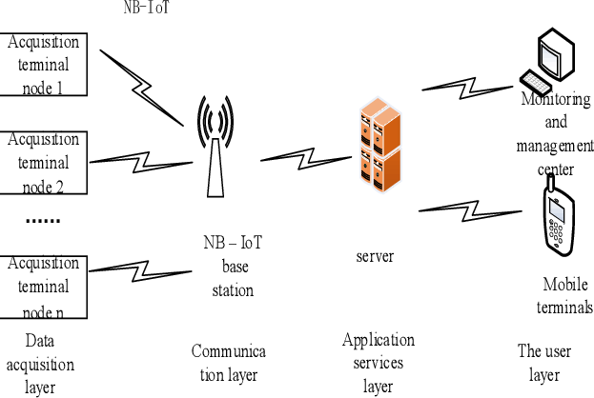
ARCHITECTURE:

Slide 11
REFERENCES:
Lazarescu, M.T., "Design of a WSN Platform for Long- Term Environmental
Monitoring for IoT Applications," Emerging and Selected Topics in Circuits and
Systems, IEEE Journal on , vol.3, no.1, pp.45,54, March 2013
Kelly, S.D.T.; Suryadevara, N.K.; Mukhopadhyay, S.C., "Towards the
Implementation of IoT for Environmental Condition Monitoring in Homes,"
Sensors Journal, IEEE, vol.13, no.10, pp.3846, 3853, Oct. 2013.
I. Akyildiz, W. Su, Y. Sankarasubramanian, E. Cayirci, “A Survey on Sensor
Networks”, IEEE Communications Magazines, August 2002.
A. OzanBicen and Ozgur B. Akan and V. CagriGungor, “Spectrum-Aware and
Cognitive Sensor Networks for Smart Grid Applications,” IEEE Communications
Magazine, No. 5pp. 158-165. 2012
J. Guevara, F. Barrero, E. Vargas, J. Becerra, S. Toral, “Environmental wireless
sensor network for road traffic applications,” IET Intell.Transp. Syst., Vol. 6, Iss.
2, pp. 177–186, 2012

Slide 12
CONCLUSION:
Underground drainage monitoring is challenging problem. This project propose different methods for monitoring and managing underground drainage system. It explains various applications like underground drainage and manhole identification in real time. Various parameters like flow and level of water, toxic gases inside vent, manhole lid open status are being monitored and updated on the internet using the Internet of Things. The status is updated instantly to the cloud

Slide 13
THANK YOU !!!

